Slide 1
Chapter 12
SUPERVISED LEARNING
Rule Algorithms and their Hybrids
Part 2
Cios / Pedrycz / Swiniarski / Kurgan

Slide 2
Rule Algorithms
Rule algorithms are also known as rule learners.
Rule induction/generation is distinct from generation of decision trees. In general, it is more complex to generate rules directly from data than to write a set of rules from a decision tree.
Algorithm | Complexity
ID3 | O(n)
C4.5 rules | O(n³)
C5.0 | O(n log n)
DataSqeezer | O(n log n)
CN2 | O(n²)
CLIP4 | O(n²)
© 2007 Cios / Pedrycz / Swiniarski / Kurgan

Slide 3
Rule Algorithms
Let us denote training dataset by D, which consists
of s examples and k attributes.
The subsets of positive examples, DP, and negative
examples, DN, satisfy these properties:
DP ∪ DN = D, DP ∩ DN = ∅, DN ≠ ∅, and DP ≠ ∅
© 2007 Cios / Pedrycz / Swiniarski / Kurgan

Slide 4
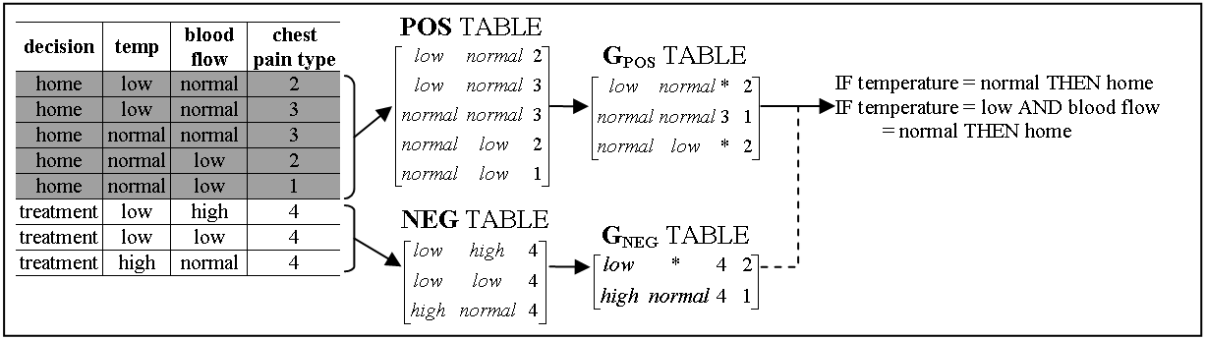
Rule Algorithms
The matrix of positive examples is denoted as POS and their number as NPOS,
and NEG denotes matrix of negative examples and their number is NNEG.
The POS and NEG matrices are formed by using all positive and negative examples; examples are stored in rows and the features form the columns.
© 2007 Cios / Pedrycz / Swiniarski / Kurgan

Slide 5
DataSqueezer Algorithm
Given: POS, NEG, k (number of attributes), s (number of examples)
Step1.
1.1 G_{POS} = DataReduction(POS, k);
1.2 G_{NEG} = DataReduction(NEG k);
Step2.
2.1 Initialize RULES = []; i=1; // where rules_{i} denotes i^{th} rule stored in RULES
2.2 create LIST = list of all columns in G_{POS}
2.3 within every G_{POS} column that is on LIST, for every non missing value a from selected column j compute sum, s_{aj}, of values of gpos_{i}[k+1] for every row i, in which a appears and multiply s_{aj}, by the number of values the attribute j has
2.4 select maximal s_{aj}, remove j from LIST, add “j = a” selector to rules_{i}
2.5.1 if rules_{i} does not describe any rows in G_{NEG}
2.5.2 then remove all rows described by rules_{i} from G_{POS}, i=i+1;
2.5.3 if G_{POS} is not empty go to 2.2, else terminate
2.5.4 else go to 2.3
Output: RULES describing POS
DataReduction (D, k) // data reduction procedure for D=POS or D=NEG
DR.1 Initialize G = []; i=1; tmp = d₁; g₁ = d₁; g₁[k+1]=1;
DR.2.1 for j=1 to N_{D} // for positive/negative data; N_{D} is N_{POS} or N_{NEG}
DR.2.2 for kk = 1 to k // for all attributes
DR.2.3 if (d_{j}[kk] ≠ tmp[kk] or d_{j}[kk] = ‘∗’)
DR.2.4 then tmp[kk] = ‘∗’; // ‘∗’ denotes missing” do not care” value
DR.2.5 if (number of non missing values in tmp ≥ 2)
DR.2.6 then g_{i} = tmp; g_{i}[k+1]++;
DR.2.7 else i++; g_{i} = d_{j}; g_{i}[k+1]=1; tmp = d_{j};
DR.2.8 return G;
© 2007 Cios / Pedrycz / Swiniarski / Kurgan

Slide 6
Summed-up values
F1 | F2 | F3 | F4 | Class
a | d | i | o
a | e | i | p
a | f | j | p
a | f | k | o
b | g | m | q
Feature | Total number of values | Summed-up values
F1 | 2 values {a, b} | v₁₁=4x2, v₅₁=1x2
F2 | 4 values {d, e, f, g} | v₁₂=1x4, v₂₂=1x4,v₃₂=2x4,v₅₂=1x4
F3 | 4 values {i, j, k, m} | v₁₃=2x4, v₃₃=1x4,v₄₃=1x4,v₅₃=1x4
F4 | 3 values {o, p, q} | v₁₄=2x3, v₂₄=2x3, v₅₄=1x3
F1, F2, and F3 have the same maximal summed-up values for the following values of features: a for F1, f for F2, and i for F3:
v₁₁ = v₃₂ = v₁₃ = 8
Threshold (pruning) on the summed-up values is used to control selection of feature selectors, which are used in the process of rule-generation.

Slide 7
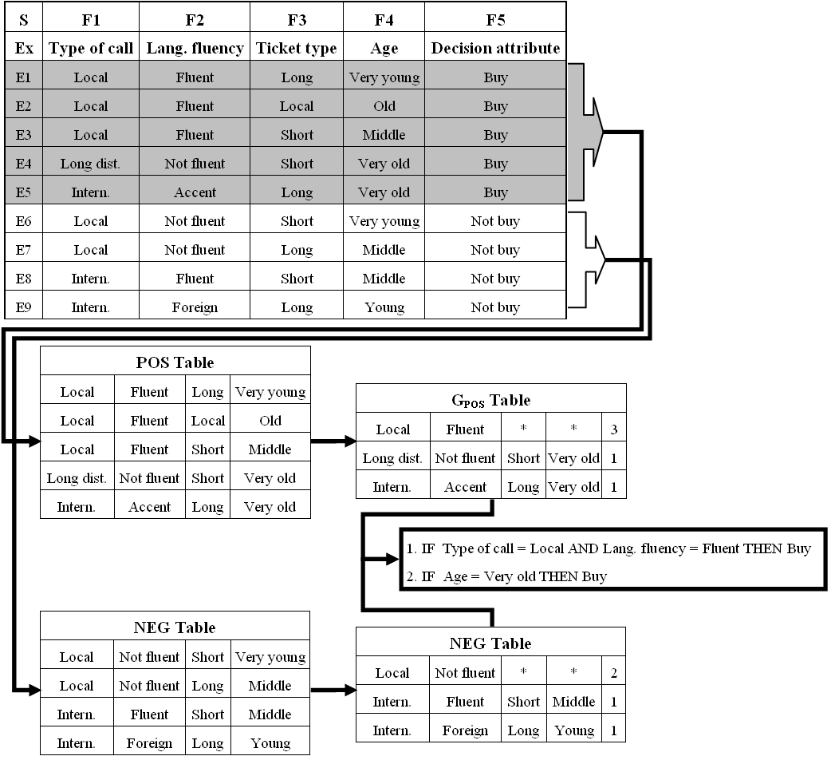
© 2007 Cios / Pedrycz / Swiniarski / Kurgan

Slide 8
Rule Algorithms
As result of the above operations the following two rules are generated that cover all 5 POS training examples:
IF TypeofCall = Local AND LangFluency = Fluent THEN Buy
IF Age = Very old THEN Buy
or
IF F1=1 AND F2=1 THEN F5=1 (covers 3 examples)
IF F4=5 THEN F5=1 (covers 2 examples)
Or, in fact:
R1: F1=1, F2=1
R2: F4=5
© 2007 Cios / Pedrycz / Swiniarski / Kurgan

Slide 9
Rule Algorithms
Pruning Threshold is used to prune very specific rules. The rule generation process is terminated if the first selector added to rule_{i} has summed-up value, sa_{j}, equal to or smaller than the threshold’s value.
Generalization Threshold is used to allow for rules that cover a small number of negative data.
It allows for accepting rules that cover some number of negative examples: number <= than this threshold.
© 2007 Cios / Pedrycz / Swiniarski / Kurgan

Slide 10
DataSqueezer Algorithm
DataSqueezer generates a set of rules for each class. Only two outcomes are possible: a test example is assigned to a particular class, or it is left unclassified.
To resolve possible conflicts:
all rules that cover a given example are found. If no rules cover it then it is left unclassified
for every class, the goodness of rules, describing this class and covering the example is summed => the example is assigned to the class with the highest summed value.
If there is a tie the example is left unclassified.
The goodness value of a rule is the percentage (or number) of the POS examples it covers.
© 2007 Cios / Pedrycz / Swiniarski / Kurgan

Slide 11
DataSqueezer Algorithm
As all unclassified examples are treated as incorrect classifications, this feature lowers classification accuracy.
This is in contrast to C5.0 and many other algorithms that use default hypothesis, which states that
if an example is not covered by any rule it is assigned to the class with the highest frequency (the default class) in the training data.
i.e., each test example is always classified, which may lead to significant but artificial improvement of accuracy.
For example, for highly unbalanced data, where one class has significantly larger number of examples,
it may lead to generation of only one rule => the default hypothesis.
© 2007 Cios / Pedrycz / Swiniarski / Kurgan

Slide 12
DataSqueezer Algorithm
# | abbr. | set | size | #class | #attrib. | test data | # | abbr. | set | size | #class | #attrib. | test data
1 | adult | Adult | 48842 | 2 | 14 | 16281 | 12 | led | LED display | 6000 | 10 | 7 | 4000
2 | bcw | Wisconsin breast cancer | 699 | 2 | 9 | 10CV | 13 | pid | PIMA indian diabetes | 768 | 2 | 8 | 10CV
3 | bld | BUPA liver disorder | 345 | 2 | 6 | 10CV | 14 | sat | StatLog satellite image | 6435 | 6 | 37 | 2000
4 | bos | Boston housing | 506 | 3 | 13 | 10CV | 15 | seg | image segmentation | 2310 | 7 | 19 | 10CV
5 | cid | census-income | 299285 | 2 | 40 | 99762 | 16 | smo | attitude smoking restr. | 2855 | 3 | 13 | 1000
6 | cmc | contraceptive method | 1473 | 3 | 9 | 10CV | 17 | spect | SPECT heart imaging | 267 | 2 | 22 | 187
7 | dna | StatLog DNA | 3190 | 3 | 61 | 1190 | 18 | tae | TA evaluation | 151 | 3 | 5 | 10CV
8 | forc | Forest cover | 581012 | 7 | 54 | 565892 | 19 | thy | thyroid disease | 7200 | 3 | 21 | 3428
9 | hea | StatLog heart disease | 270 | 2 | 13 | 10CV | 20 | veh | StatLog vehicle silhouette | 846 | 4 | 18 | 10CV
10 | ipum | IPUMS census | 233584 | 3 | 61 | 70076 | 21 | vot | congressional voting rec | 435 | 2 | 16 | 10CV
11 | kdd | Intrusion (kdd cup 99) | 805050 | 40 | 42 | 311029 | 22 | wav | waveform | 3600 | 3 | 21 | 3000
© 2007 Cios / Pedrycz / Swiniarski / Kurgan

Slide 13
Data set | C5.0 | CLIP4 | DataSqueezer
 |  |  | accuracy | sensitivity | specificity
bcw | 94 (±2.6) | 95 (±2.5) | 94 (±2.8) | 92 (±3.5) | 98 (±3.3)
bld | 68 (±7.2) | 63 (±5.4) | 68 (±7.1) | 86 (±18.5) | 44 (±21.5)
bos | 75 (±6.1) | 71 (±2.7) | 70 (±6.4) | 70 (±6.1) | 88 (±4.3)
cmc | 53 (±3.4) | 47 (±5.1) | 44 (±4.3) | 40 (±4.2) | 73 (±2.0)
dna | 94 | 91 | 92 | 92 | 97
hea | 78 (±7.6) | 72 (±10.2) | 79 (±6.0) | 89 (±8.3) | 66 (±13.5)
led | 74 | 71 | 68 | 68 | 97
pid | 75 (±5.0) | 71 (±4.5) | 76 (±5.6) | 83 (±8.5) | 61 (±10.3)
sat | 86 | 80 | 80 | 78 | 96
seg | 93 (±1.2) | 86 (±1.9) | 84 (±2.5) | 83 (±2.1) | 98 (±0.4)
smo | 68 | 68 | 68 | 33 | 67
tae | 52 (±12.5) | 60 (±11.8) | 55 (±7.3) | 53 (±8.4) | 79 (±3.8)
thy | 99 | 99 | 96 | 95 | 99
veh | 75 (±4.4) | 56 (±4.5) | 61 (±4.2) | 61 (±3.2) | 88 (±1.6)
vot | 96 (±3.9) | 94 (±2.2) | 95 (±2.8) | 93 (±3.3) | 96 (±5.2)
wav | 76 | 75 | 77 | 77 | 89
MEAN (stdev) | 78.5 (±14.4) | 74.9 (±15.0) | 75.4 (±14.9) | 74.6 (±19.1) | 83.5 (±16.7)
adult | 85 | 83 | 82 | 94 | 41
cid | 95 | 89 | 91 | 94 | 45
forc | 65 | 54 | 55 | 56 | 90
ipums | 100 | - | 84 | 82 | 97
kdd | 92 | - | 96 | 12 | 91
spect | 76 | 86 | 79 | 47 | 81
MEAN all (stdev) | 80.4 (±14.1) | 75.6 (±14.8) | 77.0 (±14.6) | 71.7 (±23.0) | 80.9 (±19.0)
© 2007 Cios / Pedrycz / Swiniarski / Kurgan

Slide 14
Data set | C5.0 |  |  | CLIP4 |  |  | DataSqueezer
 | mean # rules | mean # select | # select / rule | mean # rules | mean # select | # select / rule | mean # rules | mean # select | # select / rule
bcw | 16 | 16 | 1.0 | 4 | 122 | 30.5 | 4 | 13 | 3.3
bld | 14 | 42 | 3.0 | 10 | 272 | 27.2 | 3 | 14 | 4.7
bos | 18 | 68 | 3.8 | 10 | 133 | 13.3 | 20 | 107 | 5.4
cmc | 48 | 184 | 3.8 | 8 | 61 | 7.6 | 20 | 70 | 3.5
dna | 40 | 107 | 2.7 | 8 | 90 | 11.3 | 39 | 97 | 2.5
hea | 10 | 21 | 2.1 | 12 | 192 | 16.0 | 5 | 17 | 3.4
led | 20 | 79 | 4.0 | 41 | 189 | 4.6 | 51 | 194 | 3.8
pid | 10 | 22 | 2.2 | 4 | 64 | 16.0 | 2 | 8 | 4.0
sat | 96 | 498 | 5.2 | 61 | 3199 | 52.4 | 57 | 257 | 4.5
seg | 42 | 181 | 4.3 | 39 | 1170 | 30.0 | 57 | 219 | 3.8
smo | 0 | 0 | 0 | 18 | 242 | 13.4 | 6 | 12 | 2.0
tae | 12 | 33 | 2.8 | 9 | 273 | 30.3 | 21 | 57 | 2.7
thy | 7 | 15 | 2.1 | 4 | 119 | 29.8 | 7 | 28 | 4.0
veh | 37 | 142 | 3.8 | 21 | 381 | 18.1 | 24 | 80 | 3.3
vot | 4 | 6 | 1.5 | 10 | 52 | 5.2 | 1 | 2 | 2.0
wav | 30 | 119 | 4.0 | 9 | 85 | 9.4 | 22 | 65 | 3.0
MEAN Stdev | 25.3 (±23.9) | 95.8 (±123.5) | 2.9 (±1.4) | 16.8 (±16.3) | 415.3 (±789.1) | 18.9 (±12.7) | 21.2 (±19.8) | 77.5 (±80.3) | 3.4 (±0.9)
Adult | 54 | 181 | 3.3 | 72 | 7561 | 105.0 | 61 | 395 | 6.5
cid | 146 | 412 | 2.8 | 19 | 1895 | 99.7 | 15 | 95 | 6.3
forc | 432 | 1731 | 4.0 | 63 | 2438 | 38.7 | 59 | 2105 | 35.7
Ipums | 75 | 197 | 2.6 | - | - | - | 108 | 1492 | 13.8
kdd | 108 | 354 | 3.3 | - | - | - | 26 | 409 | 15.7
spect | 4 | 6 | 1.5 | 1 | 9 | 9.0 | 1 | 9 | 9.0
MEAN all stdev | 55.6 (±92.3) | 200.6 (±368.6) | 2.9 (±1.2) | 21.2 (±21.8) | 927.4 (±1800.6) | 28.4 (±28.2) | 27.7 (±27.6) | 261.1 (±520.2) | 6.5 (±7.4)
© 2007 Cios / Pedrycz / Swiniarski / Kurgan

Slide 15
Hybrid Algorithms
A hybrid algorithm combines methods from two or more types of algorithms
The goal of a hybrid algorithm design is to combine the most useful mechanisms of two or more algorithms to achieve better robustness, speed, accuracy, etc.
© 2007 Cios / Pedrycz / Swiniarski / Kurgan

Slide 16
Hybrid Algorithms
Hybrid algorithms that combine decision trees and rule algorithms:
CN2 algorithm (Clark and Niblett, 1989)
CLIP algorithms
CLILP2 (Cios and Liu, 1995)
CLIP3 (Cios, Wedding and Liu, 1997)
CLIP4 (Cios and Kurgan, 2004)
© 2007 Cios / Pedrycz / Swiniarski / Kurgan

Slide 17
CLIP4 Algorithm
A characteristic feature distinguishing CLIP4 from majority of ML algorithms is that it generates rules that involve inequalities.
This leads to generation of small number of rules when attributes have large number of values and are correlated with the target class.
Key mechanism used in CLIP4 is dividing the task of rule generation into subtasks and treating each as a set covering (SC) problem and solving it.
The efficient SC alg., designed expressly for CLIP4, is used to:
- select the most discriminatory features
- grow new branches of the tree
select data subsets from which to generate the least overlapping rules, and
- generate final rules from the (virtual) tree leafs (that store subsets of the data).
© 2007 Cios / Pedrycz / Swiniarski / Kurgan

Slide 18
CLIP4’s Set Covering Algorithm
CLIP4’s set covering algorithm is a simplified version of the integer programming (IP).
To transform IP into the SC problem:
1) function subject of optimization has all coefficients set to one
2) all variables are binary, x_{i}={0,1}
3) constraint function coefficients are binary
4) all constraint functions are >= 1
The SC problem is NP-hard.
© 2007 Cios / Pedrycz / Swiniarski / Kurgan

Slide 19
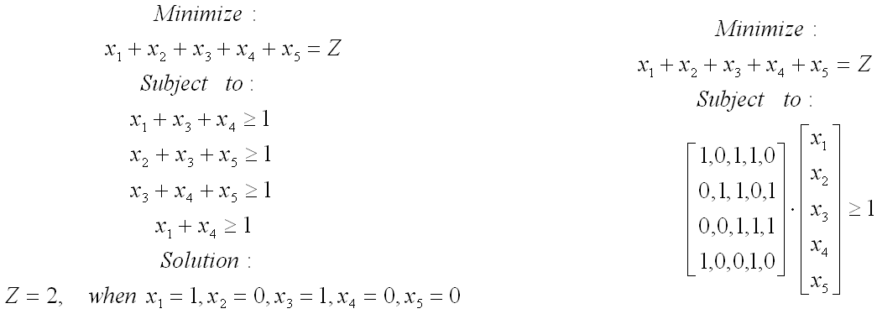
CLIP4’s Set Covering Algorithm
© 2007 Cios / Pedrycz / Swiniarski / Kurgan

Slide 20
CLIP4’s SC Algorithm
Given: BINary matrix, Initialize: Remove all empty (non-active) rows from the BINary matrix; if the matrix has no 1’s then return error.
1. Select active rows that have the minimum number of 1’s in rows – min-rows
2. Select columns that have the maximum number of 1’s within the min-rows – max-columns
3. Within max-columns find columns that have the maximum number of 1’s in all active rows – max-max-columns,
if there is more than one max-max-column go to 4., otherwise go to 5.
4. Within max-max-columns find the first column that has the lowest number of 1’s in the inactive rows
5. Add the selected column to the solution
6. Mark the inactive rows, if all the rows are inactive then stop; otherwise go to 1.
Active row is the one that is not covered by the partial solution;
the inactive row is one that is already covered by the partial solution (rules generated so far).
© 2007 Cios / Pedrycz / Swiniarski / Kurgan

Slide 21
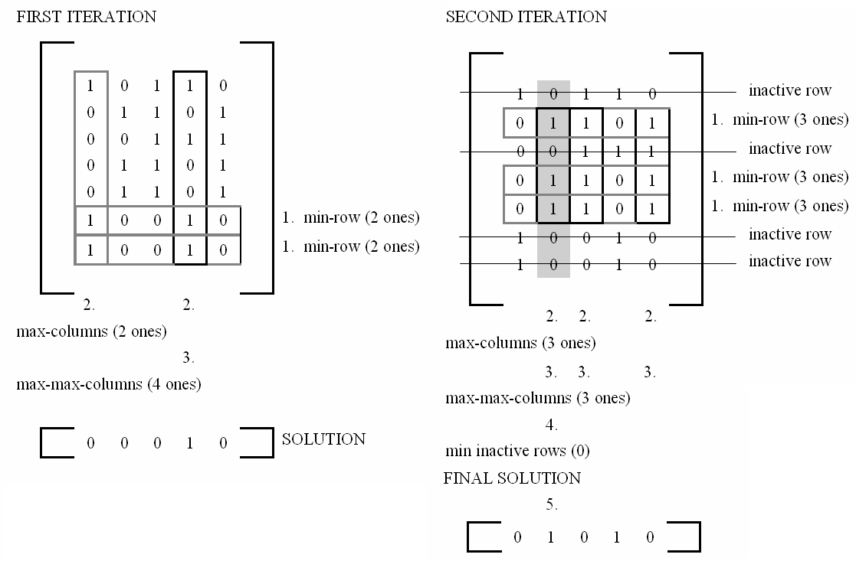
CLIP4’s Set Covering Algorithm
© 2007 Cios / Pedrycz / Swiniarski / Kurgan

Slide 22
CLIP4 Algorithm
The set of all training examples is denoted by S.
A subset of positive examples is denoted by SP and the subset of negative examples by SN.
SP and SN are represented by matrices whose rows represent examples and columns represent attributes.
Matrix of the positive examples is denoted as POS and their number by NPOS. Similarly, for the negative examples we have matrices NEG and NNEG.
The following properties are satisfied for the subsets:
SP ∪ SN=S, SP ∩ SN=∅, SN ≠ ∅, and SP ≠ ∅
© 2007 Cios / Pedrycz / Swiniarski / Kurgan

Slide 23
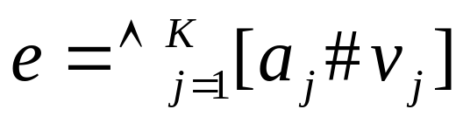
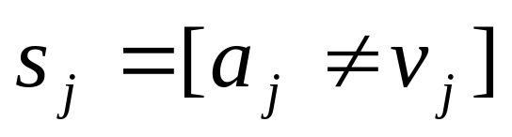
CLIP4 Algorithm
Examples are described by a set of K attribute-value pairs:
where a_{j} denotes j^{th} attribute with value v_{j} ∈ d_{j}, # is a
relation (≠, =, <, ≈, ≤, etc.), where K is the number of attributes.
An example e consists of set of selectors
CLIP4 generates rules in the form:
IF (s₁∧…∧s_{m}) THEN class = class_{i}
where all selectors are only in the form s_{i} = [a_{j} ≠ v_{j}], i.e., only inequalities are used.
© 2007 Cios / Pedrycz / Swiniarski / Kurgan

Slide 24
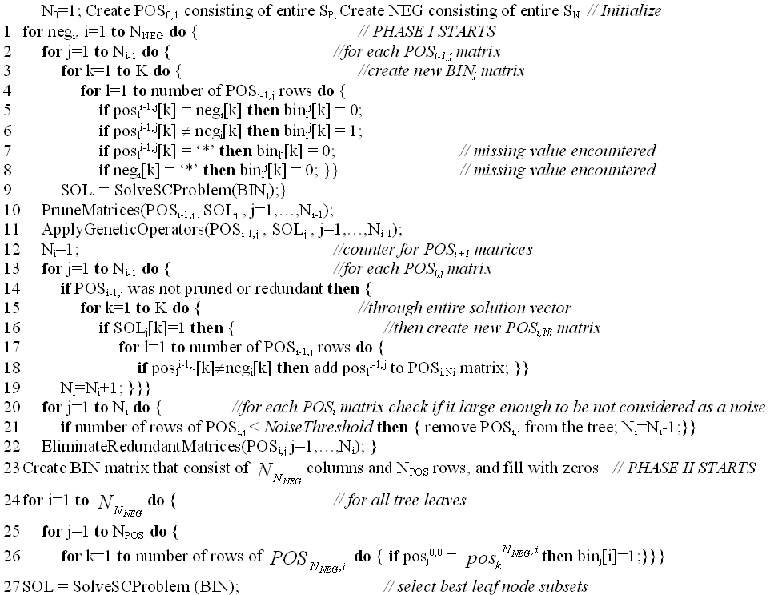
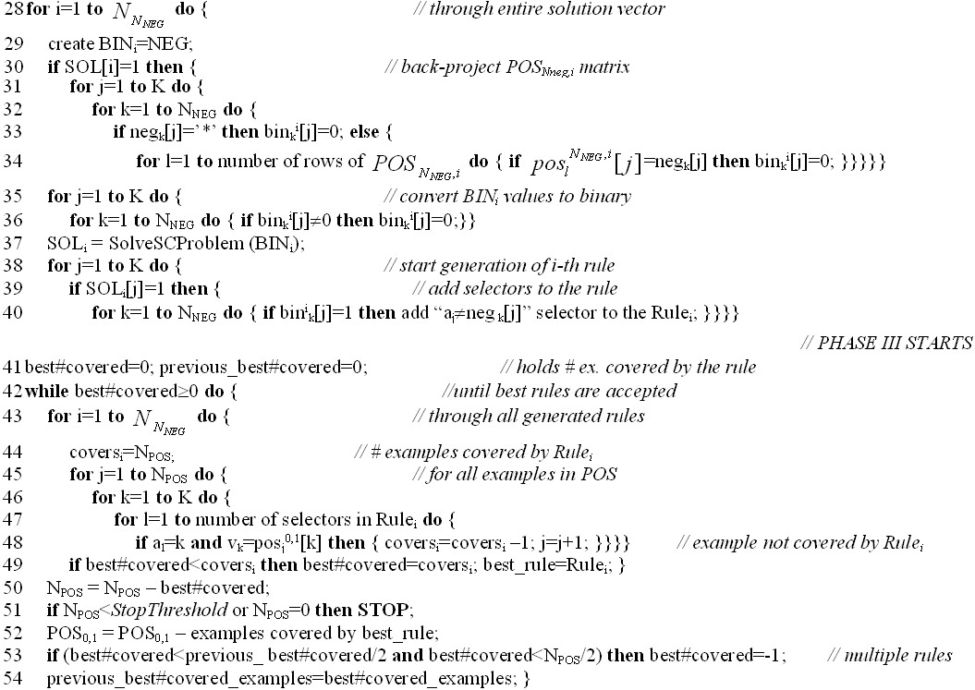
CLIP4 Algorithm
1
© 2007 Cios / Pedrycz / Swiniarski / Kurgan

Slide 25
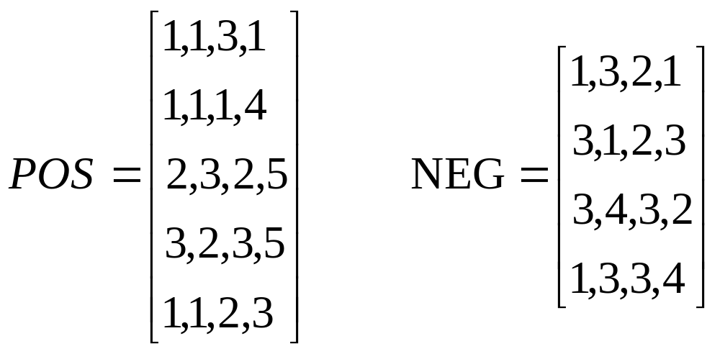
CLIP4 Algorithm
© 2007 Cios / Pedrycz / Swiniarski / Kurgan

Slide 26
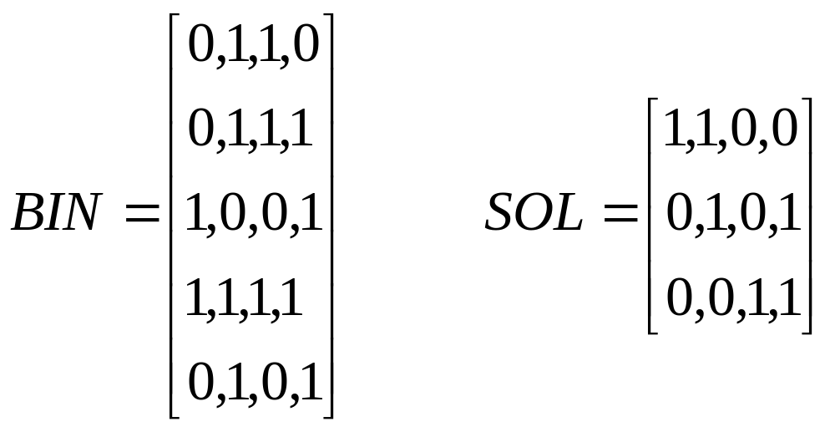
CLIP4 Algorithm
Phase 1: Use the first negative example [1,3,2,1] and matrix POS
to create the BINARY matrix
←
© 2007 Cios / Pedrycz / Swiniarski / Kurgan

Slide 27
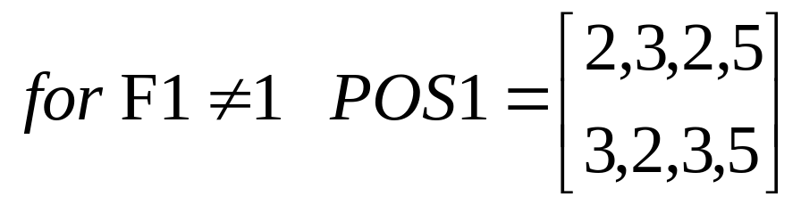
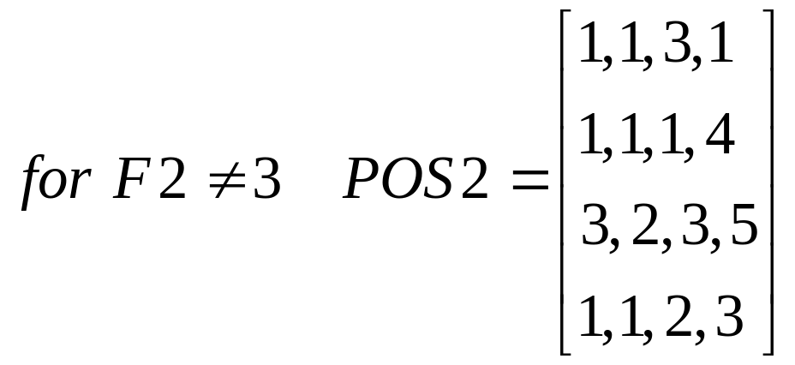
CLIP4 Algorithm
© 2007 Cios / Pedrycz / Swiniarski / Kurgan

Slide 28
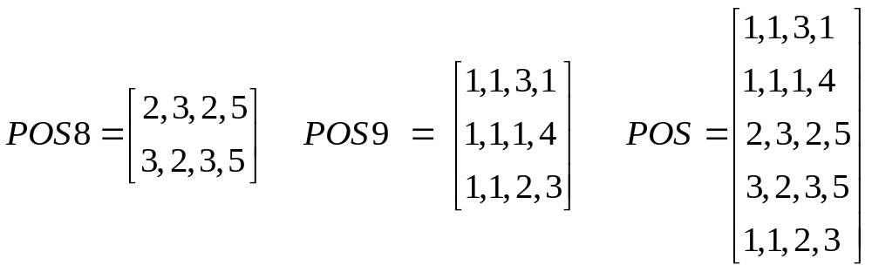
CLIP4 Algorithm
Phase 2: After repeating the process, at the end of Phase 1 we end up
with just two matrices - the leaf nodes of the virtual decision tree
(#s 8&9 are not important)
© 2007 Cios / Pedrycz / Swiniarski / Kurgan

Slide 29
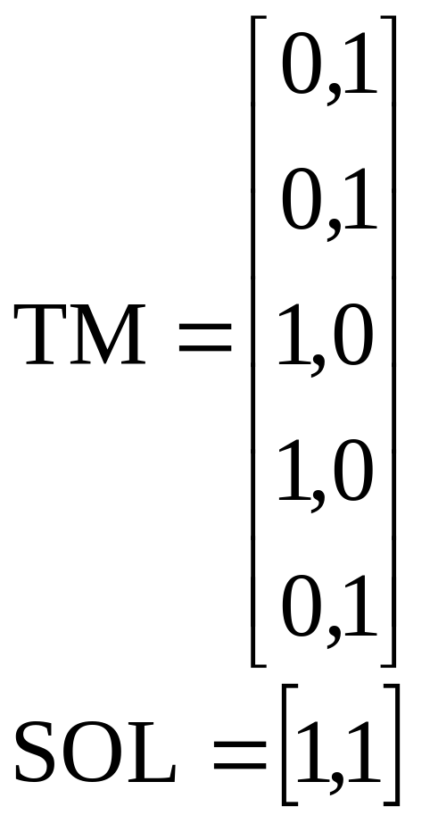
CLIP4 Algorithm
© 2007 Cios / Pedrycz / Swiniarski / Kurgan

Slide 30
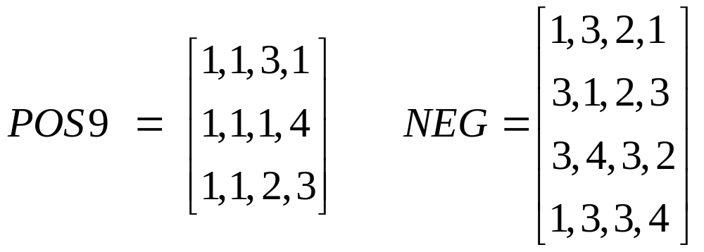
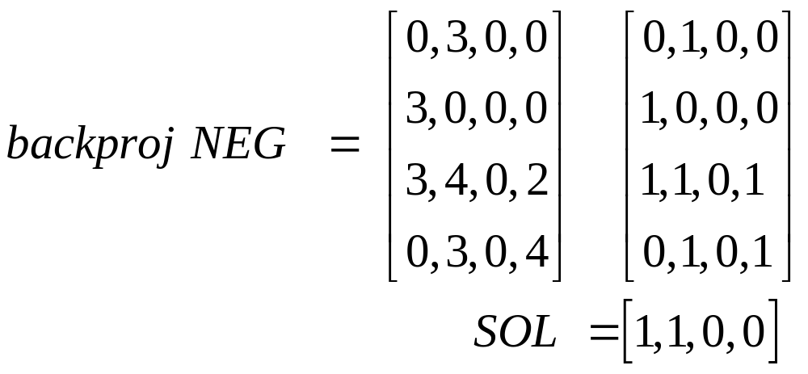
CLIP4 Algorithm
0
0
© 2007 Cios / Pedrycz / Swiniarski / Kurgan

Slide 31
CLIP4 Algorithm
From this solution and from the backproj NEG matrix
the first rule is generated:
IF (F1≠3) AND (F2≠3) AND (F2≠4) THEN F5=Buy
(covers examples e1,e2 and e5)
Similarly, using POS8 another rule is generated:
IF (F4≠1) AND (F4≠3) AND (F4≠2) AND (F4≠4)
THEN F5=Buy
(covers examples e3 and e4)
© 2007 Cios / Pedrycz / Swiniarski / Kurgan

Slide 32
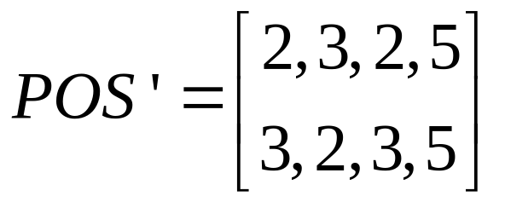
CLIP4 Algorithm
Phase 3: CLIP4 is using heuristic that calls for keeping only the strong
rules – so only the first rule is kept. Then remove from POS all examples
covered by it.
Next, we the entire process is repeated on the reduced POS:
After going again through all the phases just one rule is generated:
IF (F4≠1) AND (F4≠3) AND (F4≠2) AND (F4≠4) THEN F5=Buy
© 2007 Cios / Pedrycz / Swiniarski / Kurgan

Slide 33
CLIP4 Algorithm
Thus, in two iterations, the algorithm generated rules that cover all positive examples and none of the negative:
IF (F1≠3) AND (F2≠3) AND (F2≠4) THEN F5=Buy
IF (F4=5) THEN F5=Buy
Notice that by knowing feature values for attribute F4 it is possible to convert the second rule into the equality rule as shown above.
Verbally the rules say:
IF Call ≠ International AND Language Fluency ≠ Bad AND Language Fluency ≠ Foreign THEN Buy
IF Customer is 80 years or older THEN Buy
© 2007 Cios / Pedrycz / Swiniarski / Kurgan

Slide 34
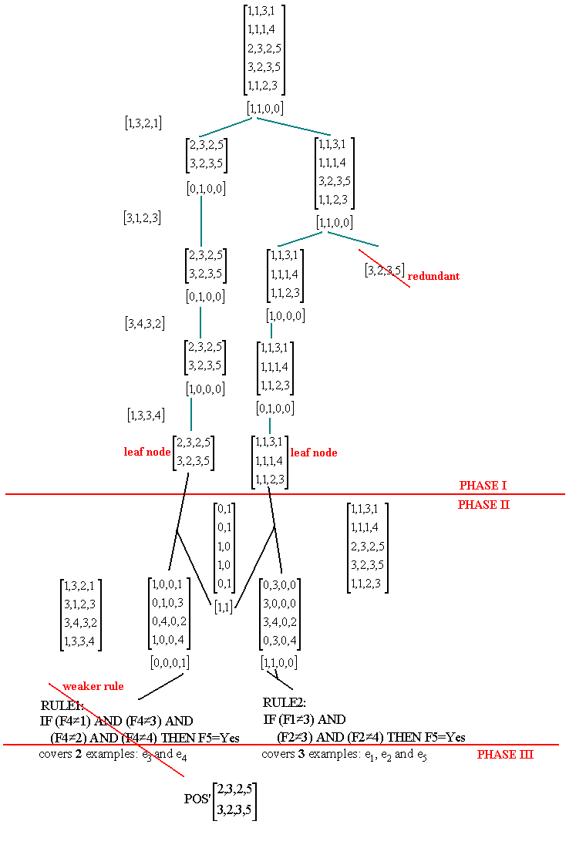
CLIP4 Algorithm
© 2007 Cios / Pedrycz / Swiniarski / Kurgan

Slide 35
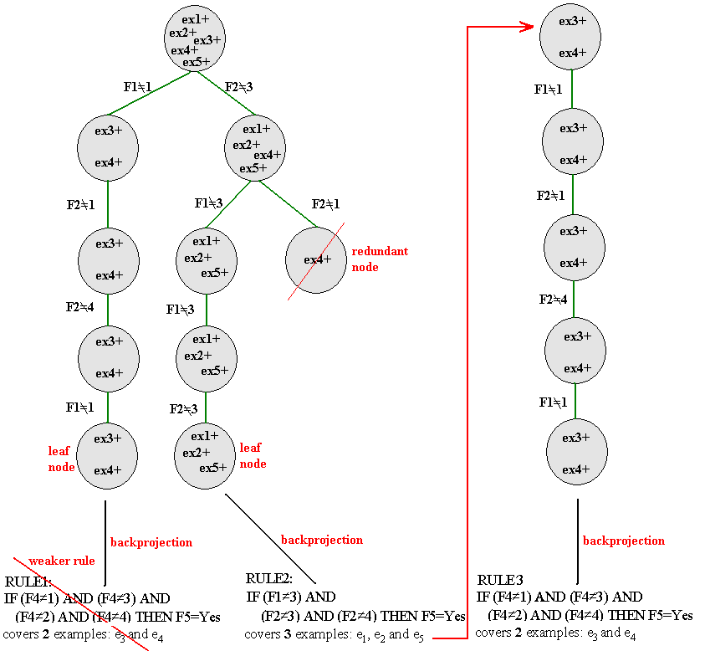
CLIP4
Algorithm
© 2007 Cios / Pedrycz / Swiniarski / Kurgan

Slide 36
Handling Missing Values
ex. # | F1 | F2 | F3 | F4 | class
1 | 1 | 2 | 3 | * | 1
2 | 1 | 3 | 1 | 2 | 1
3 | * | 3 | 2 | 5 | 1
4 | 3 | 3 | 2 | 2 | 1
5 | 1 | 1 | 1 | 3 | 1
6 | 3 | 1 | 2 | 5 | 2
7 | 1 | 2 | 2 | 4 | 2
8 | 2 | 1 | * | 3 | 2
In Phase1 * is replaced by 0
when generating a new branch
and
again by 0 when doing backprojection in Phase2
IF F1≠3 AND F1≠2 AND F3≠2 THEN class 1 (covers ex. 1,2,5)
IF F2≠2 AND F2≠1 THEN class 1 (covers ex. 2,3,4)
The rules cover all positive examples, including those with missing values
and none of the negative examples.
Notice that both rules cover the second example.
© 2007 Cios / Pedrycz / Swiniarski / Kurgan

Slide 37
Thresholds
Noise Threshold determines which nodes are pruned from the tree grown in Phase 1.
It prunes every node that contains less number of examples than its value.
Pruning Threshold prunes nodes from the generated tree by using a goodness value.
It selects the first few nodes with the highest value and removes the remaining nodes from the tree.
Stop Threshold stops the algorithm when smaller than the threshold number of positive examples are uncovered.
CLIP4 generates rules by partitioning data into subsets containing similar examples.
The noise and stop thresholds are specified as percentage of the size of positive data and thus are easily scalable.
© 2007 Cios / Pedrycz / Swiniarski / Kurgan

Slide 38
Evolutionary Computing
Evolutionary computing performs population-oriented evolution-like optimization
It exploits the entire population of potential solutions and converges according to genetics-driven principles
Genetic algorithms (GA) are search algorithms based on mechanisms of natural selection and genetics
© 2007 Cios / Pedrycz / Swiniarski / Kurgan

Slide 39
GA: Algorithmic Aspects
GA exploits the mechanism of natural selection – survival
of the fittest - via:
  collecting an initial population of N individuals
  determining suitability for survival of individuals
  evolving the population to retain the individuals with the highest values of the fitness function
  eliminating the weakest individuals
Result: Individuals with the highest ability to survive
© 2007 Cios / Pedrycz / Swiniarski / Kurgan

Slide 40
GA: Algorithmic Aspects
GA uses the concept of recombination and mutation of individual elements, called chromosomes, to:
- generate new offspring, and
- increase diversity
respectively.
© 2007 Cios / Pedrycz / Swiniarski / Kurgan

Slide 41
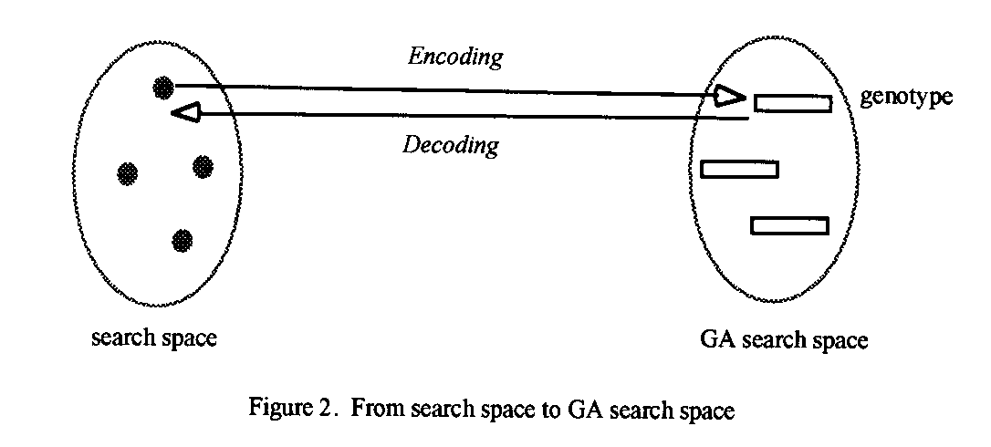
GA: Algorithmic Aspects
To perform genetic operations the original space has to
be transformed into a GA search space (encoding).
© 2007 Cios / Pedrycz / Swiniarski / Kurgan

Slide 42
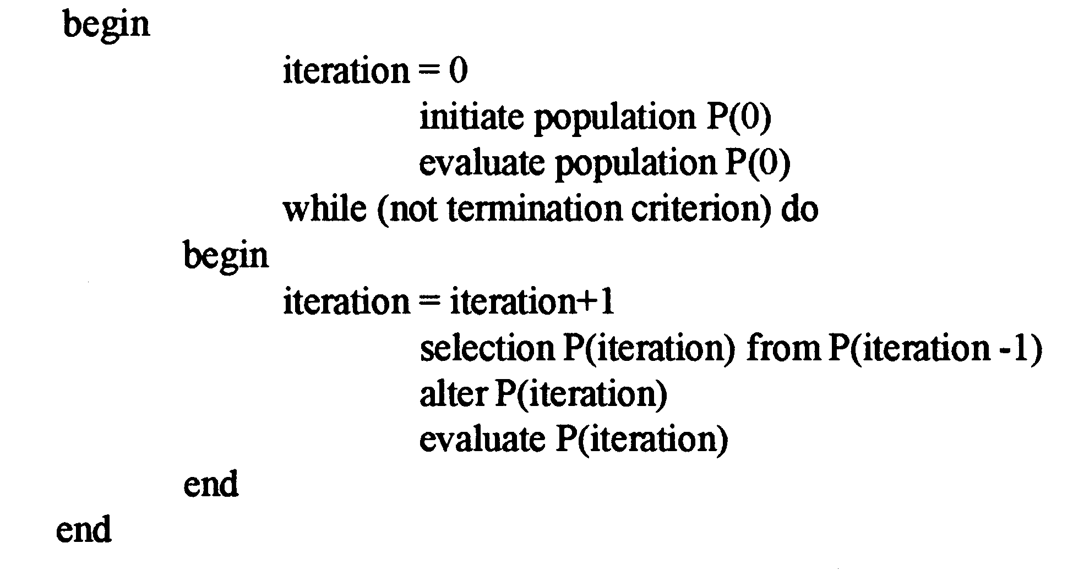
GA Pseudocode
© 2007 Cios / Pedrycz / Swiniarski / Kurgan

Slide 43
GA Pseudocode
GA pseudocode:
start with an initial population and evaluate each of its elements by a fitness function:
elements with high fitness have high chance of survival
while those with low fitness are gradually eliminated
© 2007 Cios / Pedrycz / Swiniarski / Kurgan

Slide 44
Fundamental Components of GAs
The main components of genetic computing are:
    encoding and decoding
    selection
    crossover
    mutation
© 2007 Cios / Pedrycz / Swiniarski / Kurgan

Slide 45
Fundamental Components of GAs
Encoding
Encoding transforms a real number into its binary equivalent.
It transforms the original problem into a format suitable for genetic computations.
Decoding
Decoding transforms elements from the GA search space back to the original search space
© 2007 Cios / Pedrycz / Swiniarski / Kurgan

Slide 46
Selection Mechanism
When a population of chromosomes is established, we must define a way in which the chromosomes are selected for next optimization steps.
Selection methods include:
  roulette wheel
  elitist strategy
© 2007 Cios / Pedrycz / Swiniarski / Kurgan

Slide 47
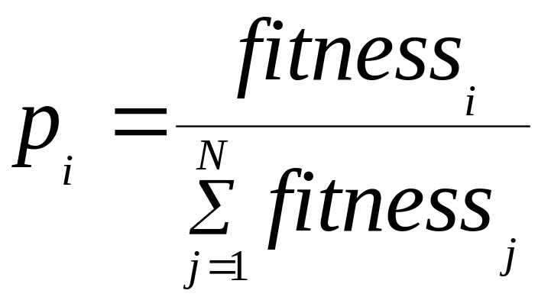
Roulette Wheel
Fitness values of the elements are normalized to 1
The normalized values are viewed as probabilities
The sum of fitness in the denominator describes total fitness of the population P.
© 2007 Cios / Pedrycz / Swiniarski / Kurgan

Slide 48
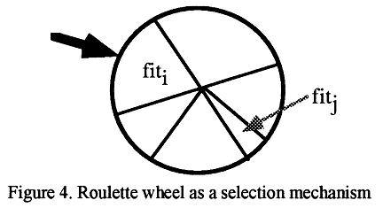
Roulette Wheel
Construct a roulette wheel with sectors reflecting probabilities of the chromosomes and spin it N times.
© 2007 Cios / Pedrycz / Swiniarski / Kurgan

Slide 49
Elitist Strategy
Select the best individuals (strings/chromosomes)
in the population and carry them over,
without any alteration, to the next population.
© 2007 Cios / Pedrycz / Swiniarski / Kurgan

Slide 50
Fundamental Components of GAs
Once the selection is completed, the resulting new population is subject to two GA mechanisms:
  crossover
  mutation
© 2007 Cios / Pedrycz / Swiniarski / Kurgan

Slide 51
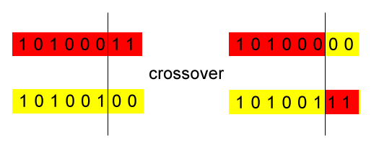
Crossover
A one-point crossover mechanism chooses two strings and randomly selects a position in the strings at which they interchange their content, thus producing two new offsprings.
© 2007 Cios / Pedrycz / Swiniarski / Kurgan

Slide 52
Crossover
Crossover leads to an increased diversity of the population of strings, as the new individuals with new properties emerge.
The intensity of crossover is characterized in terms of the probability at which the elements of strings are affected; the higher the probability, the more individuals are affected.
© 2007 Cios / Pedrycz / Swiniarski / Kurgan

Slide 53
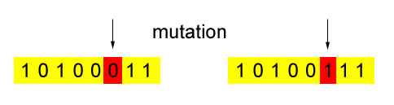
Mutation
Mutation adds additional diversity of a stochastic nature.
It is implemented by flipping the values of some randomly selected bits.
© 2007 Cios / Pedrycz / Swiniarski / Kurgan

Slide 54
Mutation
Mutation rate is related to the probability at which individual bits are affected
Example
5% mutation:
If applied to a population of 50 strings, each 20 bits long,
then 5% of 1000 bits will be changed = 50 bits
© 2007 Cios / Pedrycz / Swiniarski / Kurgan

Slide 55
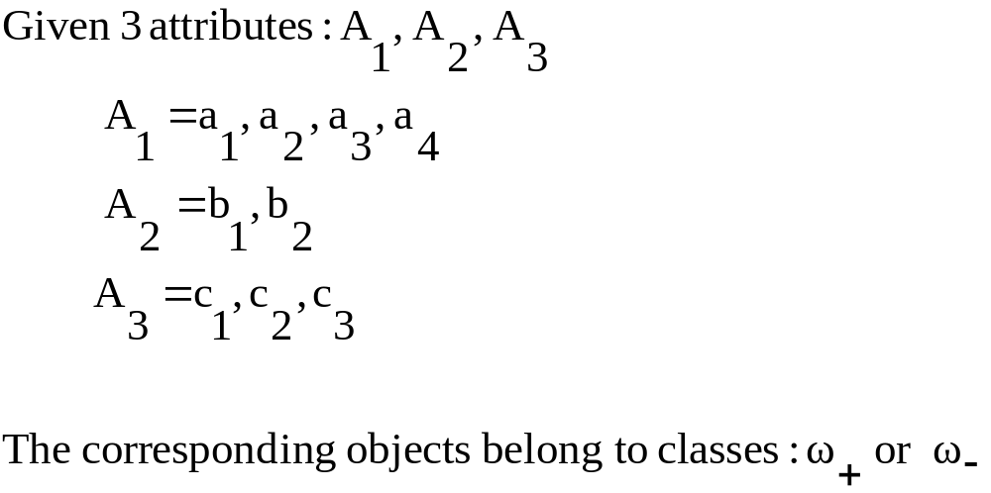
Rule Encoding Example
Task: derive (generate) rules that describe classes using GAs
© 2007 Cios / Pedrycz / Swiniarski / Kurgan

Slide 56
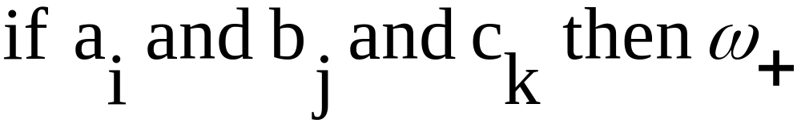
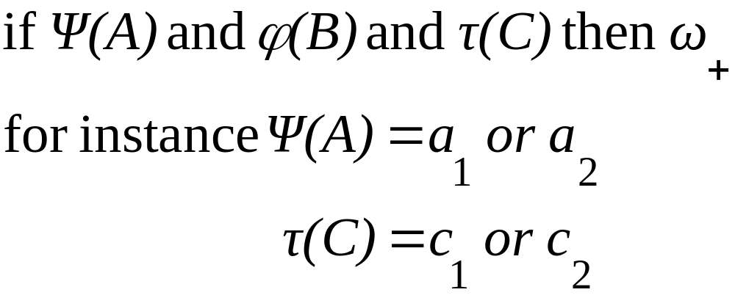
Rule Encoding Example
Structure of the rule:
where i=1,2,3,4 and j=1,2 and k=1,2,3
More generally:
© 2007 Cios / Pedrycz / Swiniarski / Kurgan

Slide 57
Rule Encoding / Decoding Example
Assuming a single bit per value for encoding each attribute, we have:
    4 bit string: 1100 for the 1st attribute
    2 bit string: 01
    3 bit string: 001 for the 3rd
Therefore, each rule encodes as a string of 9 bits, e.g., 110001001
which decodes as:
and we generate randomly several such rules for the initial population.
© 2007 Cios / Pedrycz / Swiniarski / Kurgan

Slide 58
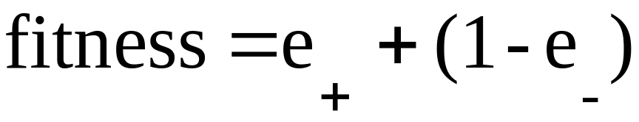
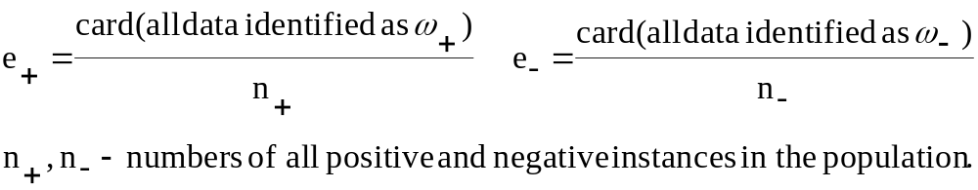
Rule Encoding Example
Fitness function describes how well each rule describes the data:
e₊ is a fraction of positive instances covered by the rule
e₋ is a fraction of the instances identified by the rule as not belonging to the positive class
© 2007 Cios / Pedrycz / Swiniarski / Kurgan

Slide 59
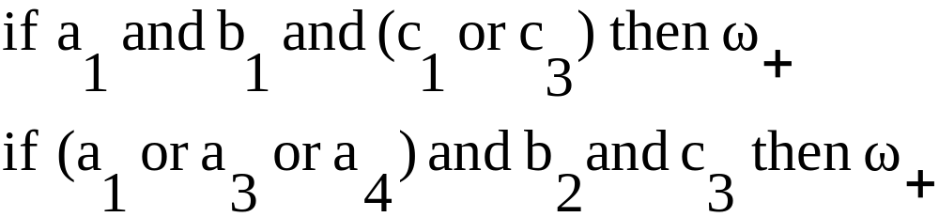
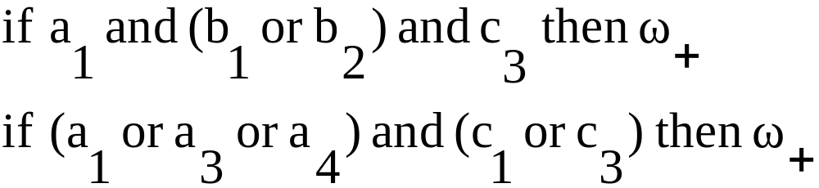
Crossover Mechanism Example
Let’s use two strings to illustrate crossover:
100010101
101101001
Swapping after the fifth bit results in:
100011001
101100101
© 2007 Cios / Pedrycz / Swiniarski / Kurgan

Slide 60
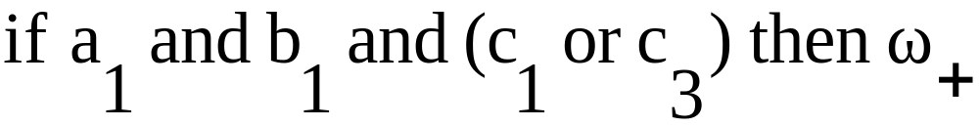
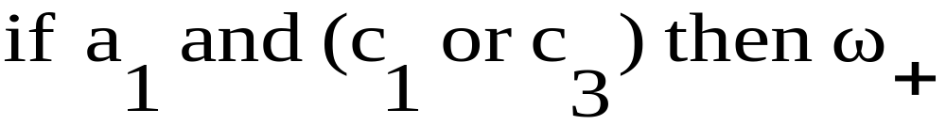
Mutation Mechanism Example
Using mutation
100010101
changes it into
100000101
© 2007 Cios / Pedrycz / Swiniarski / Kurgan

Slide 61
Use of GA Operators to Improve Accuracy
CLIP4 uses the GA in Phase I to enhance the partitioning of the data and obtain more “general” subsets at the leaf level. The components of the genetic module are:
population and individual
Individual/chromosome is defined as a node in the tree and consists of: POS_{i,j} matrix (jth matrix at the ith tree level) and SOL_{i,j} (the solution to the SC problem obtained from POS_{i,j} matrix)
Population is defined as a set of nodes at the same level of the tree.
encoding and decoding scheme
There is no need for encoding using the individuals as defined above since GA operators are used only on the SOL_{i,j} vector
© 2007 Cios / Pedrycz / Swiniarski / Kurgan

Slide 62
Use of GA Operators to Improve Accuracy
selection of the new population
Initial population is the first tree level that consists of at least two nodes. CLIP4 uses this fitness function to select individuals for the next generation:
In words: it is calculated as the number of rows of the POS_{i,j} matrix divided by the number of 1’s in the SOL_{i,j} vector.
It has high values for the tree nodes that contain a large number of examples with low branching factor.
© 2007 Cios / Pedrycz / Swiniarski / Kurgan

Slide 63
Use of GA Operators to Improve Accuracy
The mechanism for selecting individuals for the next population:
All individuals are ranked using their fitness
Half of the individuals with the highest fitness are selected for the next population (they will branch to create nodes for the next tree level)
The second half is generated by matching the best with the worst individuals
(the best with the worst, the 2nd best with the 2nd worst, etc.)
and using GA operators to obtain new individuals (new nodes in the tree).
© 2007 Cios / Pedrycz / Swiniarski / Kurgan

Slide 64
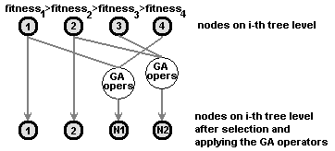
Use of GA Operators to Improve Accuracy
Selection
© 2007 Cios / Pedrycz / Swiniarski / Kurgan

Slide 65
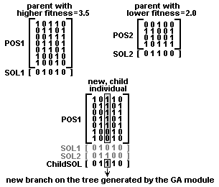
Use of GA Operators to Improve Accuracy
© 2007 Cios / Pedrycz / Swiniarski / Kurgan

Slide 66
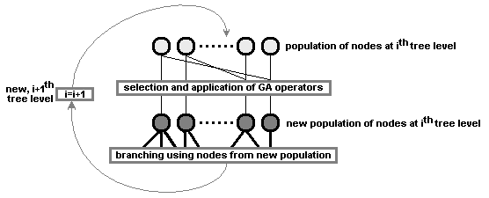
Use of GA Operators to Improve Accuracy
© 2007 Cios / Pedrycz / Swiniarski / Kurgan

Slide 67
Pruning
CLIP4 prunes the tree grown in Phase 1 as follows:
First, it selects a number (via pruning threshold) of the best (highest fitness) nodes at the i-th tree level. Only the selected nodes are used to branch into new nodes at the (i+1)th tree level.
Second, all redundant nodes are removed. Two nodes are redundant if one mode contains positive examples that are identical, or form a subset of positive examples, of the other node.
Third, after the redundant nodes are removed, each new node is evaluated using the noise threshold. If it contains less examples than the threshold then it is pruned.
© 2007 Cios / Pedrycz / Swiniarski / Kurgan

Slide 68
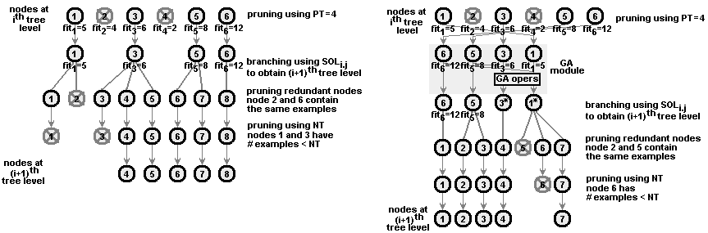
Pruning
© 2007 Cios / Pedrycz / Swiniarski / Kurgan

Slide 69
Feature and Selector Ranking
Goodness of each attribute and selector is computed from the
generated rules.
Attributes with goodness greater than zero are relevant and cannot be removed without decreasing accuracy.
The attribute and selector goodness values are computed in these steps:
Each rule has a goodness value equal to the percentage of the training positive examples it covers
Each selector has a goodness value equal to the goodness of the rule it comes from
Each attribute has a goodness value equal to the sum of scaled goodness values of all its selectors divided by the total number of attribute values
© 2007 Cios / Pedrycz / Swiniarski / Kurgan

Slide 70
Feature and Selector Ranking
Assume a two-category data, described by 5 attributes:
a1 = {1, 2, 3}, a2 = {1, 2, 3}, a3 = {1, 2}, a4 = {1, 2, 3}, a5 = {1, 2, 3, 4}, and a6 = {1, 2} a decision attribute.
Suppose CLIP4 generated these rules with their % goodness:
IF a5≠2 and a5≠3 and a5≠4 THEN class = 1
(covers 46% (29/62) positive examples)
IF a1≠1 and a1≠2 and a2≠2 and a2≠1 THEN class = 1
(covers 27% (17/62) positive examples)
IF a1≠1 and a1≠3 and a2≠3 and a2≠1 THEN class = 1
(covers 24% (15/62) positive examples)
IF a1≠2 a1≠3 and a2≠2 and a2≠3 THEN class = 1
(covers 14% (9/62) positive examples)
© 2007 Cios / Pedrycz / Swiniarski / Kurgan

Slide 71
Feature and Selector Ranking
Using the information about attribute values we can re-write the rules as equality rules:
IF a5=1 THEN class = 1
(covers 46% (29/62) positive examples)
IF a1=3 and a2=3 THEN class = 1
(covers 27% (17/62) positive examples)
IF a1=2 and a2=2 THEN class = 1
(covers 24% (15/62) positive examples)
IF a1=1 and a2=1 THEN class = 1
(covers 14% (9/62) positive examples)
© 2007 Cios / Pedrycz / Swiniarski / Kurgan

Slide 72
Feature and Selector Ranking
First calculate goodness values for the selectors and then the goodness of attributes:
(a5, 1); goodness 46
(a1, 3) and (a2, 3); goodness 27
(a1, 2) and (a2, 2); goodness 24
(a1, 1) and (a2, 1); goodness 14
To show their relative goodness we scale them to the 0-100 range:
(a5, 1); goodness 100
(a1, 3) and (a2, 3); goodness 58.7
(a1, 2) and (a2, 2); goodness 52.2
(a1, 1) and (a2, 1); goodness 30.4
© 2007 Cios / Pedrycz / Swiniarski / Kurgan

Slide 73
Feature and Selector Ranking
For attribute a1 we have these selectors and their goodness values:
(a1,3) with goodness 58.7,
(a1,2) with goodness 52.2, and
(a1,1) with goodness 30.4.
Thus the goodness of the first attribute is:
(58.7+52.2+30.4)/3 = 47.1
Similarly we calculate goodness of a2.
For attribute a5, we have the following selectors and their goodness
values: (a5,1) with goodness 100, AND (a5,2) through (a5,4) each with
goodness of 0, thus a5’s goodness is: (100+0+0+0)/4 = 25.0
Attributes, a3, a4 and a6, have all goodness value of 0 because they
are not used in the generated rules.
© 2007 Cios / Pedrycz / Swiniarski / Kurgan

Slide 74
Feature and Selector Ranking
The feature and selector ranking performed by CLIP4 algorithm can be used to:
Select only relevant attributes (and thus discard the irrelevant ones)
The user can safely discard all attributes with goodness of 0 and still have the correct (with the same accuracy) model.
Provide additional insight into data properties, e.g.,
the selector ranking can help in analyzing data in terms of relevance of the selectors to the classification task.
© 2007 Cios / Pedrycz / Swiniarski / Kurgan

Slide 75
References
Cios K.J. and Liu N. 1992. Machine learning in generation of a neural network architecture: a Continuous ID3 approach. IEEE Trans. on Neural Networks, 3(2):280‑291
Cios, K.J., Pedrycz, W. and Swiniarski, R. 1998. Data Mining Methods for Knowledge Discovery. Kluwer
Cios, K.J. and Kurgan, L. 2004. CLIP4: Hybrid Inductive Machine Learning Algorithm that Generates Inequality Rules. Information Sciences, 163 (1-3): 37-83
Kurgan L., Cios K.J. and Dick S. 2006. Highly Scalable and Robust Rule Learner: Performance Evaluation and Comparison, IEEE Trans. on Systems Man and Cybernetics, Part B, 36(1):32-53
Kurgan, L. and Cios, K.J. 2002. CAIM Discretization Algorithm, IEEE Trans. on Knowledge and Data Engineering, 16(2): 145-153
© 2007 Cios / Pedrycz / Swiniarski / Kurgan

